Slide 1
gitHub
is a web-based Git repository hosting service, which offers all of the distributed revision control and source code management (SCM) functionality of Git as well as adding its own features.
Unlike Git, which is strictly a command-line tool, GitHub provides a web-based graphical interface and desktop as well as mobile integration.

Slide 2
Sample GitHub Flow Chart
Repository / Project
Branch / Version #
Branch / Version #
Branch / Version #
Files
Files
Files
Files
Files
Files
Files
Files
Files

Slide 3
Requirements for GitHub
1. Register Account
Install GitHub Windows
- https://windows.github.com/
3. Create Repository / Project

Slide 4

Creating Repository / Project
Go to https://github.com/ and login your account.
After login was successful click the “New repository”.

Slide 5
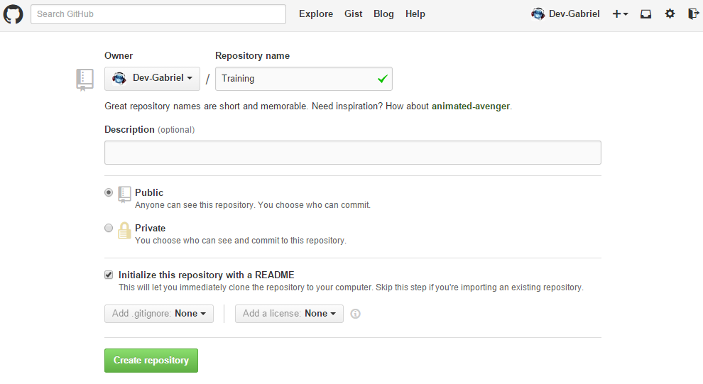
Creating Repository / Project
Enter the desired Repository name. Then check “Initialize this repository with a README”. Then click “Create repository”.

Slide 6
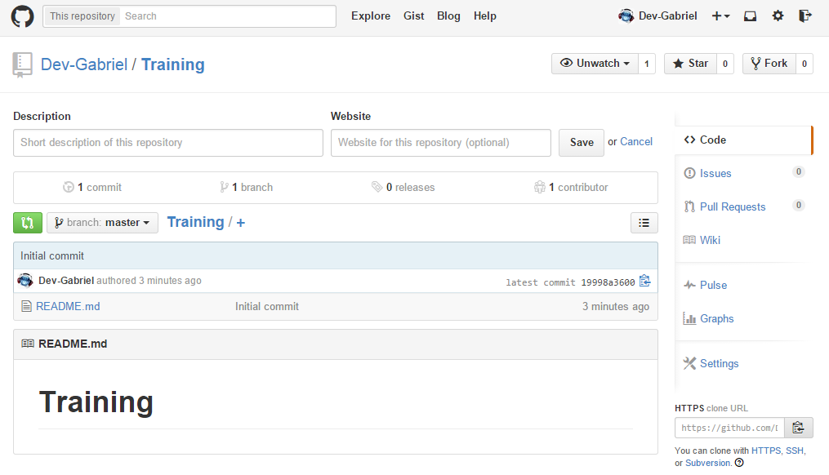
Creating Repository / Project
If you see the image below you are now successfully add the repository.

Slide 7
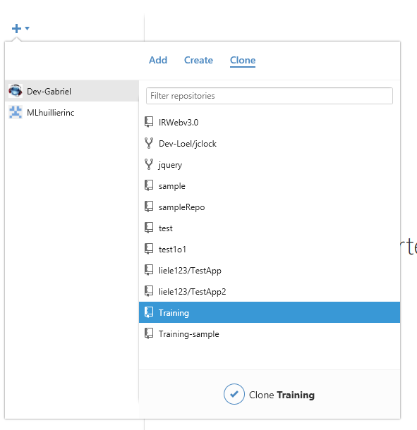
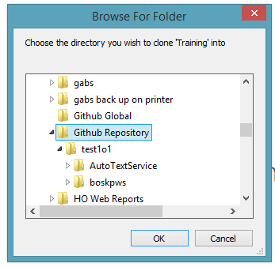

Adding Branch / Version
Open the installed GitHub application in your computer.
In the Github application click the “+” button. Then select “Clone” and find the desired Repository you want to clone to your computer.

Slide 8
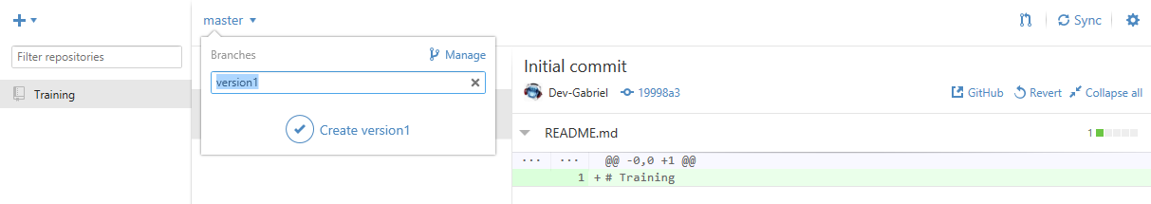
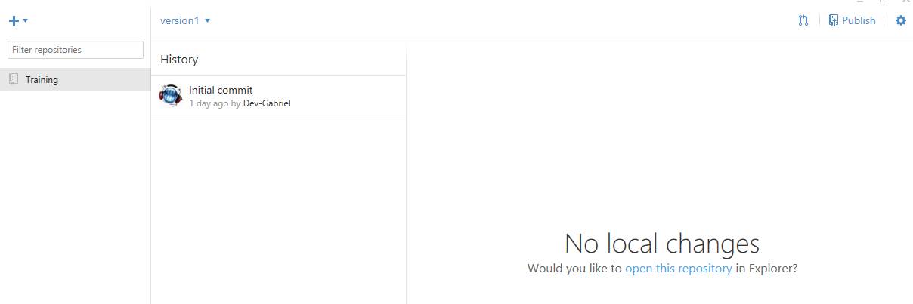
Adding Branch / Version
Click the master branch then add a specific branch then click create.
If you see the image below you are now successfully add the branch to your computer. Then click the “Publish” button to add the branch to the GitHub site.

Slide 9
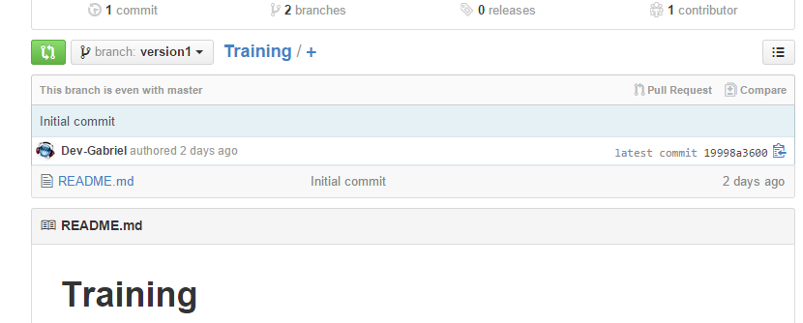
Adding Branch / Version
To verify the new branch added go to the GitHub site and you must see like the image below.

Slide 10
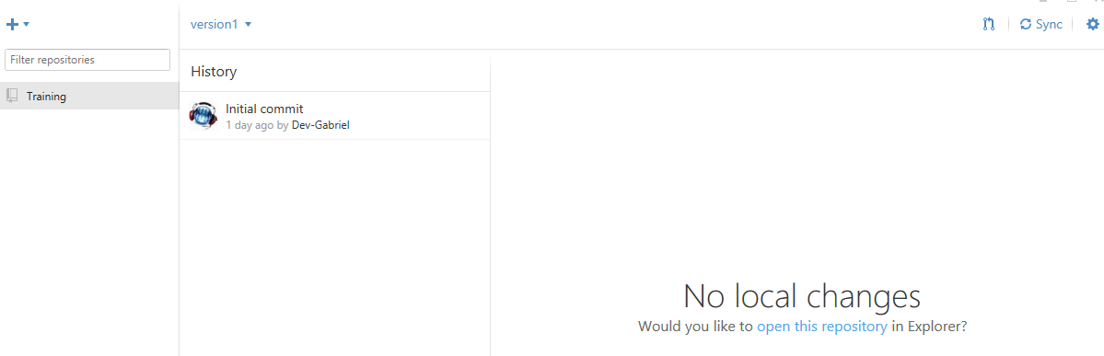
Adding files to Branch / Version
Open the installed GitHub application in your computer.
Select the repository.
Select the branch you want to add a file/s.
Click “open this repository” in Explorer.

Slide 11
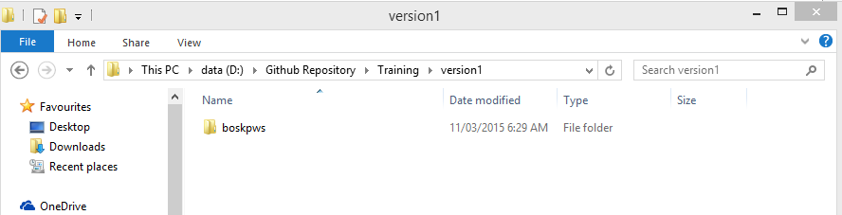
Adding files to Branch / Version
In your explorer create a folder that the filename is the same to your branch name. Paste the file/s inside the folder.

Slide 12
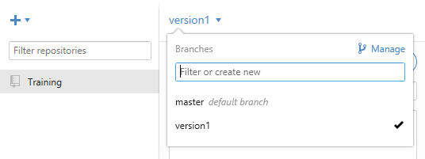
Adding files to Branch / Version
Open the installed GitHub application in your computer.
Select the specific Branch/Version you want to add the file.

Slide 13
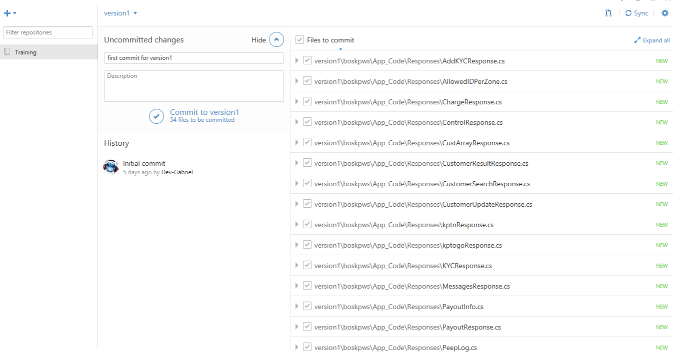
Adding files to Branch / Version
Select the file to add.
Input a summary for pushing the file to GitHub site.
Click “Commit” button.

Slide 14
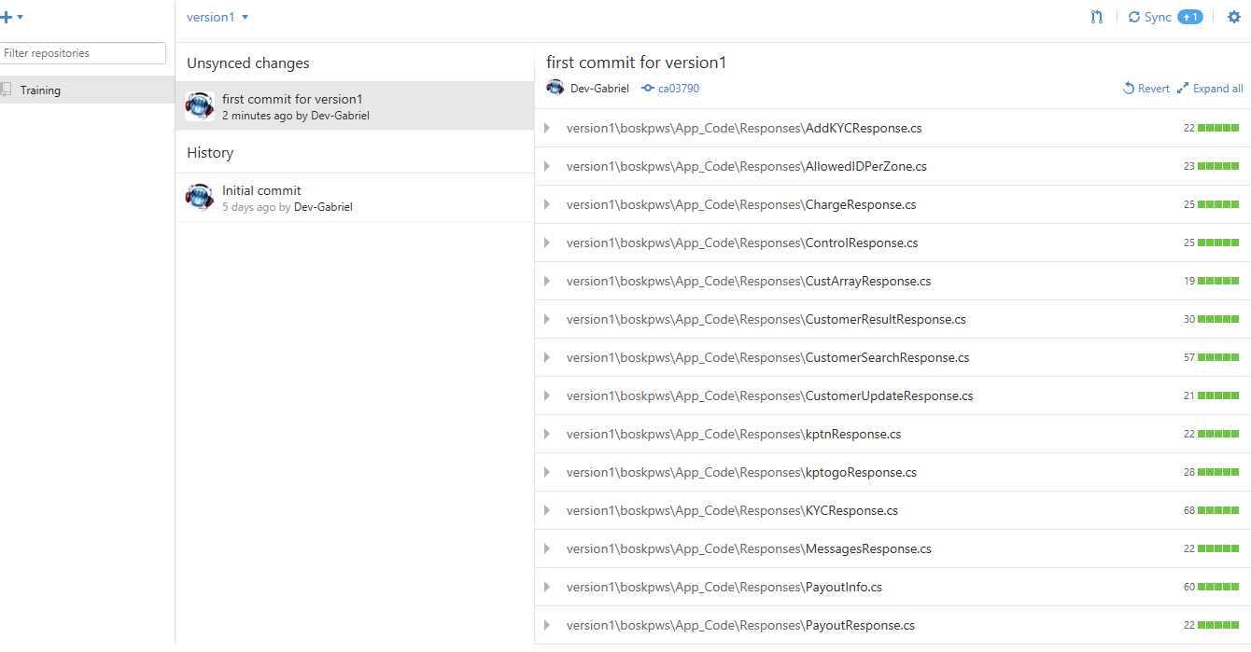
Adding files to Branch / Version
Click “Sync” button” to push to GitHub site.

Slide 15
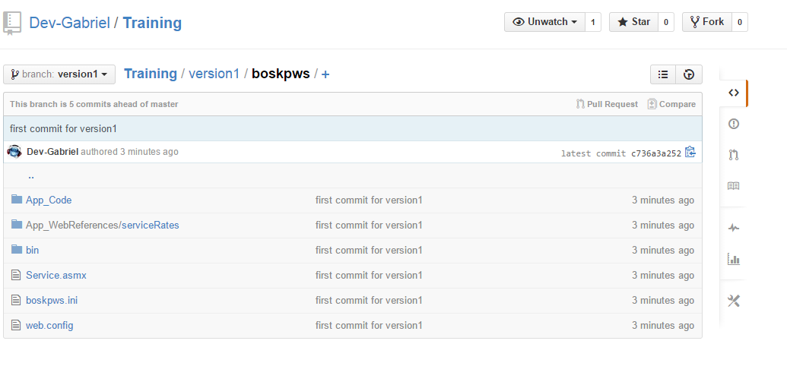
Adding files to Branch / Version
Go to the GitHub site.
Select the Branch and now you can see the file/s that has been added.

Slide 16


